Slide 1
Beauty Product Recommendation
Big Data Analysis​

Slide 2


Presenter
A
K. Pavithra Devi – 2021103707
N. Nazma - 2021103301

Slide 3
Abstract
This study explores recommendation systems, focusing on the interplay between popularity-based methods and collaborative filtering techniques.
We propose a hybrid recommendation approach that combines the simplicity of popularity-based models with the personalized nature of collaborative filtering.
The hybrid approach involves pre-filtering items based on popularity scores, followed by refining recommendations using collaborative filtering methods such as Item-item similarity and matrix factorization.
By integrating both approaches, our system aims to provide diverse and accurate recommendations that cater to individual user preferences while maintaining computational efficiency and addressing cold-start issues.
Beauty Product Recommendation

Slide 4
Introduction
Recommendation systems are essential in guiding users to relevant content or products online.
Popularity-based methods offer simplicity but may overlook individual user preferences.
Collaborative filtering techniques, like Item-item similarity and matrix factorization, provide personalized recommendations.
This paper explores integrating both approaches to enhance recommendation accuracy and user satisfaction.
Our proposed hybrid system aims to balance recommendation diversity and computational efficiency.
The goal is to provide users with tailored recommendations, improving their experience online.
Beauty Product Recommendation

Slide 5
Existing System
1. Sentiment Analysis Integration:
Utilizes sentiment analysis (Logistic Regression, Naive Bayes, LSTM) to predict review helpfulness.
Relies on user reviews, ratings, and experiences for sentiment analysis.
2. Item-Based Collaborative Filtering:
Implements k-Nearest Neighbors for item-based collaborative filtering.
Identifies similar items based on user interactions.
Limitations:
Sentiment Analysis Accuracy: May not capture nuanced opinions accurately.
Limited Personalization: Overlooks individual preferences, providing less personalized recommendations.
Complexity: Requires computational resources and expertise.
D

Slide 6
Problem Statement
In online platforms, recommendation systems are crucial for enhancing user experience. However, traditional methods often give generic suggestions, while collaborative filtering can be computationally heavy. This paper aims to merge both approaches to offer accurate and personalized recommendations efficiently.
Beauty Product Recommendation

Slide 7
Solution
Popularity-Based Pre-Filtering: Initially, we utilize popularity-based methods to pre-filter a pool of candidate items based on their overall popularity scores derived from user interactions.
Collaborative Filtering Refinement: Subsequently, we employ collaborative filtering techniques, such as the Item-item similarity model or matrix factorization, to refine the pre-filtered candidate list and generate personalized recommendations tailored to each user's preferences.
Hybrid Recommendation Generation: Finally, we combine the results from the popularity-based pre-filtering and collaborative filtering refinement stages to generate a final list of recommendations that strike a balance between popularity and personalization.
Beauty Product Recommendation

Slide 8
Literature Survey – Deep Learning
Author | Title | Algorithm Used | Limitation
Yang and others [13] | Implementation of a New E-commerce Product Recommendation System | Bidirectional Gated Recurrent Unit (Bi-GRU), Convolutional Neural Network (CNN) | High time complexity due to hybridization of deep-learning models
Onan [14] | Integration of GloVe Word Embedding and TF-IDF for Sentiment Analysis | CNN with Long Short-Term Memory (LSTM) | Increased system complexity due to integration of multiple models
Suresh and Belinda [15] | Suresh and Belinda [15]: Integration of Broyden–Fletcher Goldfarb–Shanno Algorithm with GRU for Product Recommendation | Broyden–Fletcher Goldfarb–Shanno algorithm with GRU | Higher processing time with larger datasets
Kolhe and others [16] | Utilization of Stop-word Removal and Lemmatization for Enhanced Product Recommendation | Feature selection: Swarm intelligence-based optimization algorithm - Clustering: Novel clustering algorithm | Ineffectiveness in learning the nature of the product and customer behavior
Beauty Product Recommendation

Slide 9
Literature Survey – Machine Learning
Author | Title | Algorithm Used | Limitation
Zhao and others [42] | Utilization of Web Scraping and ENN for Sentiment Analysis of Customer Reviews | - Data extraction and preprocessing: Web-scraping tool, snowball stemming, Genism lemmatization, tokenization - Feature extraction: Term weighting method - Feature selection and classification: Improved bat algorithm, Elman Neural Network (ENN) | Expensive model requiring a large number of customer reviews for better classification performance
Gokalp and others [45] | Sentiment Classification using Iterated Greedy Algorithm | Iterated Greedy Algorithm (wrapper algorithm) | Needs to address other common problems like synonymy and scalability.
Hamdi [46] | Integration of SVM with Ant Colony Optimization (ACO) for Sentiment Classification | Support Vector Machine (SVM) with Ant Colony Optimization (ACO) | Increased computational time during sentiment classification.
Beauty Product Recommendation

Slide 10
OBJECTIVE
Personalization: Tailor recommendations based on individual user preferences, historical interactions, and demographic information to enhance user satisfaction and engagement.
Accuracy: Develop recommendation algorithms that accurately predict user preferences and product ratings, minimizing recommendation errors and maximizing relevance.
Novelty: Introduce innovative techniques such as dynamic user profiling, contextual recommendations, and semantic similarity matching to provide unique and novel recommendations to users.
Scalability: Design a scalable system architecture capable of handling large volumes of data and user interactions, ensuring optimal performance and responsiveness under varying loads.
Adaptability: Implement mechanisms to adapt and evolve the recommendation system over time, incorporating user feedback, market trends, and changes in user preferences to continuously improve recommendation quality.
I

Slide 11
Proposed System
Popularity-Based Pre-Filtering: In this stage, items are initially sorted based on their overall popularity scores, which are determined by aggregating user interactions such as ratings or purchases. This pre-filtering step helps identify the most popular items across the entire user base.
Collaborative Filtering Refinement: After pre-filtering, the system employs collaborative filtering methods, such as Item-item similarity and matrix factorization, to refine the recommendations. Collaborative filtering leverages user-item interactions and similarities to generate personalized recommendations tailored to individual user preferences.
J

Slide 12
Benefits
Enhanced Recommendation Quality: By combining popularity-based pre-filtering with collaborative filtering refinement, the system offers more nuanced and accurate recommendations. It considers both overall item popularity and user-specific preferences, resulting in recommendations that are both popular and relevant to the user's interests.
Improved User Satisfaction: The personalized nature of the recommendations increases the likelihood of user satisfaction. Users receive suggestions that align with their tastes and preferences, leading to a more engaging and fulfilling experience.
Balanced Popularity and Personalization: The hybrid approach strikes a balance between recommending popular items, which ensures relevance to a broad user base, and providing personalized recommendations tailored to individual preferences.
Addressing Cold-Start Issues: The system effectively mitigates cold-start problems by leveraging popularity-based pre-filtering to recommend popular items to new or less-active users, while also utilizing collaborative filtering to refine recommendations as more user data becomes available.
Computational Efficiency: The hybrid system maintains computational efficiency by utilizing the simpler popularity-based pre-filtering stage for initial recommendations.
J

Slide 13
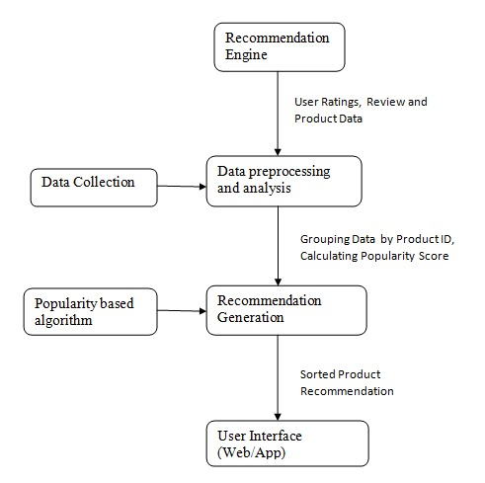
Architecture Diagram
Item - item similarity
Matrix factorization

Slide 14
Algorithm Used – Popularity based Recommendation
User-Item Interaction Matrix: Begin with a matrix where rows represent users and columns represent items. Each cell in the matrix holds the user's interaction (e.g., ratings, purchases) with the item.
Popularity Calculation: Calculate the popularity of each item based on user interactions. This can be done by counting the number of interactions (e.g., number of ratings, purchases) each item receives from users.
Ranking: Rank the items based on their popularity scores in descending order. The most popular items will have the highest ranks.
Recommendation Generation: Recommend the top-N items with the highest popularity scores to users. These recommendations are independent of the user's preferences and are solely based on the overall popularity of the items among all users.
Beauty Product Recommendation

Slide 15
Item to Item Similarity Algorithm
User-Item Interaction Matrix: Begin with a matrix where rows represent users and columns represent items. Each cell in the matrix holds the interaction (e.g., ratings) between a user and an item.
Item Similarity Calculation: Calculate the similarity between items based on user interactions. Common similarity measures include cosine similarity, Pearson correlation coefficient, or Jaccard similarity.
Neighborhood Selection: For a given item, select a subset of similar items based on their calculated similarity scores. This subset forms the "neighborhood" of the item.
Rating Prediction: Predict the rating that a user would give to an item by considering the ratings of similar items in the neighborhood. Weighted averages or other aggregation methods are typically used for this prediction.
Top-N Recommendations: Finally, recommend the top-N items with the highest predicted ratings to the user. These recommendations are based on the items that are most similar to those the user has interacted with previously.
Beauty Product Recommendation

Slide 16
Matrix Factorization Algorithm
User-Item Interaction Matrix: Begin with a matrix where rows represent users, columns represent items, and each cell contains the user's interaction (e.g., rating) with the item.
Matrix Decomposition: Decompose the user-item interaction matrix into two lower-dimensional matrices: a user matrix and an item matrix. These matrices capture latent factors or features that represent user preferences and item characteristics.
Latent Factor Learning: By factorizing the original matrix, the algorithm learns latent factors for both users and items. Each latent factor represents a characteristic or feature that contributes to the user's preference for an item.
Matrix Reconstruction: Multiply the user matrix and item matrix to reconstruct the original user-item interaction matrix. Rating Prediction: Predict the rating that a user would give to an item by considering the corresponding entry in the reconstructed matrix.
Top-N Recommendations: Finally, recommend the top-N items with the highest predicted ratings to the user based on their preferences and interactions with other items.
Beauty Product Recommendation

Slide 17
IMPLEMENTATION

Slide 18
IMPLEMENTATION COLLAB FILE https://colab.research.google.com/drive/1gBew9luAeiOqRHAWc_dqwfxAmFUdwOJ0?usp=sharing DATASET https://www.kaggle.com/datasets/skillsmuggler/amazon-ratings

Slide 19
Dataset
This dataset contains product reviews and metadata from Amazon, including 142.8 million reviews spanning May 1996 - July 2014.
This dataset includes reviews (ratings, text, helpfulness votes), product metadata (descriptions, category information, price, brand, and image features), and links (also viewed/also bought graphs).
This is a dataset related to over 2 Million customer reviews and ratings of Beauty related products sold on their website.
It contains:
the unique UserId (Customer Identification),
the product ASIN (Amazon's unique product identification code for each product),
Ratings (ranging from 1-5 based on customer satisfaction) and
the Timestamp of the rating (in UNIX time)

Slide 20
Performance Metrics
Mean Squared Error (MSE) and Root Mean Squared Error (RMSE)
They are commonly used to measure the difference between predicted ratings and actual ratings. In the code, MSE and RMSE are calculated to evaluate the performance of the popularity-based recommendation system.
MSE (Mean Squared Error)
MSE = (1/n) * Σ(y_true - y_pred)^2
where:
y_true is the actual value
y_pred is the predicted value
n is the number of data points
RMSE (Root Mean Square Error)
RMSE = √(MSE) or
RMSE = √[(1/n) * Σ(y_true - y_pred)^2]
where:
y_true is the actual value
y_pred is the predicted value
n is the number of data points
Q

Slide 21
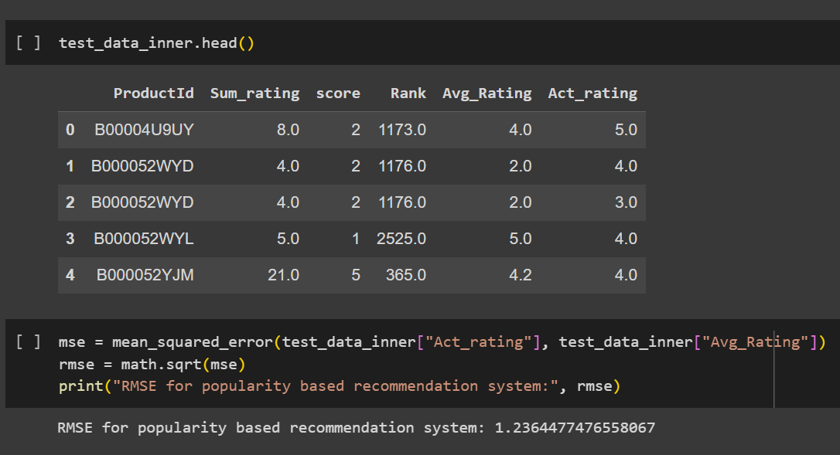
Performance Metric Evaluation – Popularity based model

Slide 22
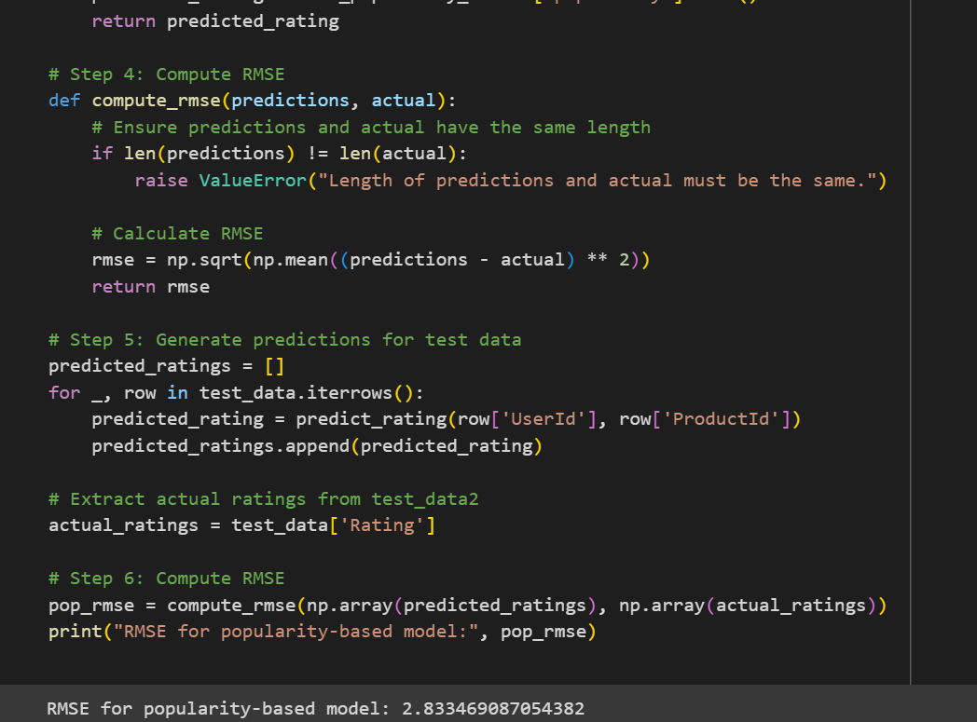
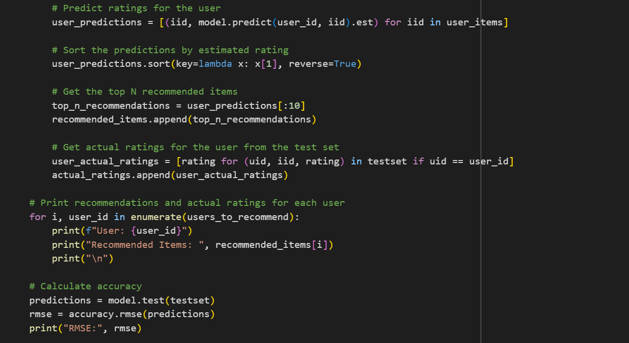
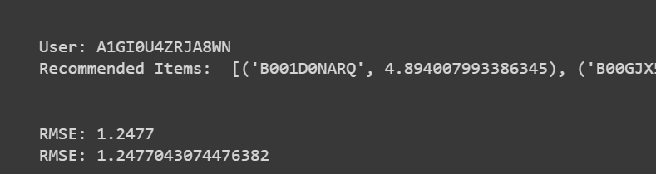
Item – Item Similarity model & Matrix Factorization model

Slide 23
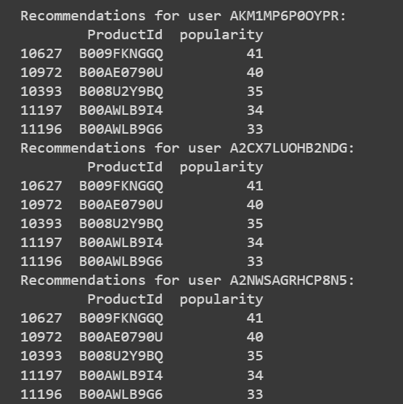
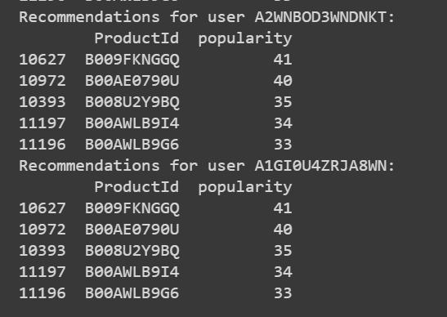
Output of Popularity based model

Slide 24
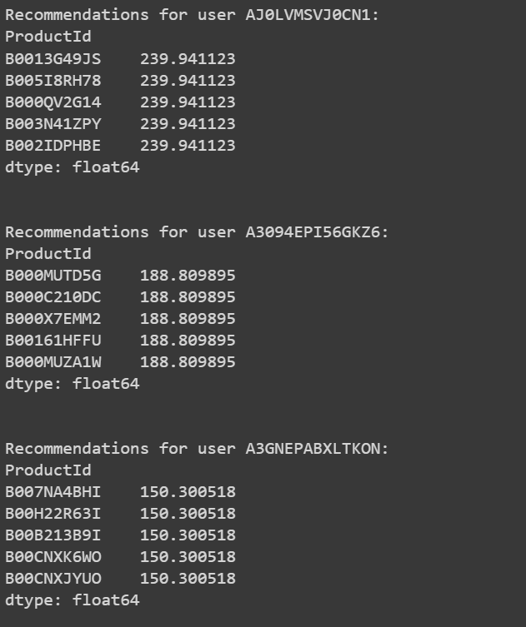
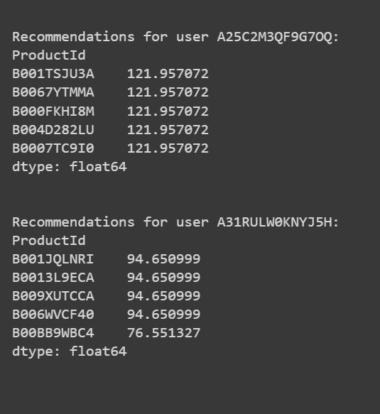
Output of Item-Item Similarity model

Slide 25
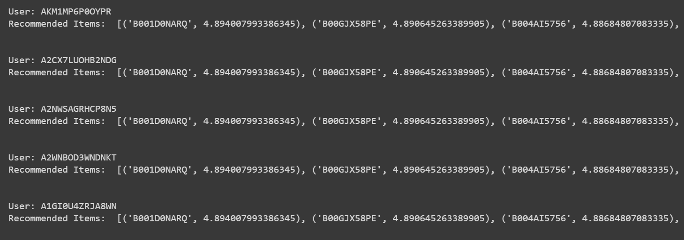
Output of Matrix Factorization

Slide 26
Future Scope
Integration of Emerging Technologies: Explore the integration of emerging technologies such as augmented reality (AR) and virtual reality (VR) to enhance the user experience by allowing users to virtually try on beauty products before making a purchase.
Enhanced Contextual Recommendations: Further refine contextual recommendations by incorporating real-time data sources such as weather conditions, social media trends, and user activity on other platforms to provide even more relevant and timely suggestions.
Multimodal Recommendations: Extend the recommendation system to support multimodal inputs, including images, videos, and voice commands, allowing users to interact with the system in more diverse and natural ways.
Global Expansion: Expand the recommendation system to cater to a global audience by incorporating language localization, cultural preferences, and region-specific product offerings to accommodate diverse beauty markets worldwide.
Beauty Product Recommendation

Slide 27
Reference
Koren, Y., & Bell, R. (2009). Advances in collaborative filtering. In Recommender systems handbook (pp. 145-186). Springer, Boston, MA. Link
Desrosiers, C., & Karypis, G. (2011). A comprehensive survey of neighborhood-based recommendation methods. In Recommender Systems Handbook (pp. 107-144). Springer, Boston, MA. Link
Herlocker, J. L., Konstan, J. A., & Riedl, J. (2002). An empirical analysis of design choices in neighborhood-based collaborative filtering algorithms. Information retrieval, 5(4), 287-310. Link
Linden, G., Smith, B., & York, J. (2003). Amazon.com recommendations: item-to-item collaborative filtering. IEEE Internet computing, 7(1), 76-80. Link
Liu, Q., Chen, J., Chen, M., & Zhao, J. L. (2019). Deep learning for recommender systems: A concise survey. In 2019 IEEE 5th International Conference on Computer and Communications (ICCC) (pp. 1703-1708). IEEE. Link
V

Slide 28
Thank you

